Slide 1
Operating System Process Scheduling
Tahira Alam
University of Asia Pacific

Slide 2
CPU Switches from Process to Process

Slide 3
Process Scheduling Queues
Job queue – set of all processes in the system
Ready queue – set of all processes residing in main memory, ready and waiting to execute
Device queues – set of processes waiting for an I/O device
Processes migrate among the various queues

Slide 4
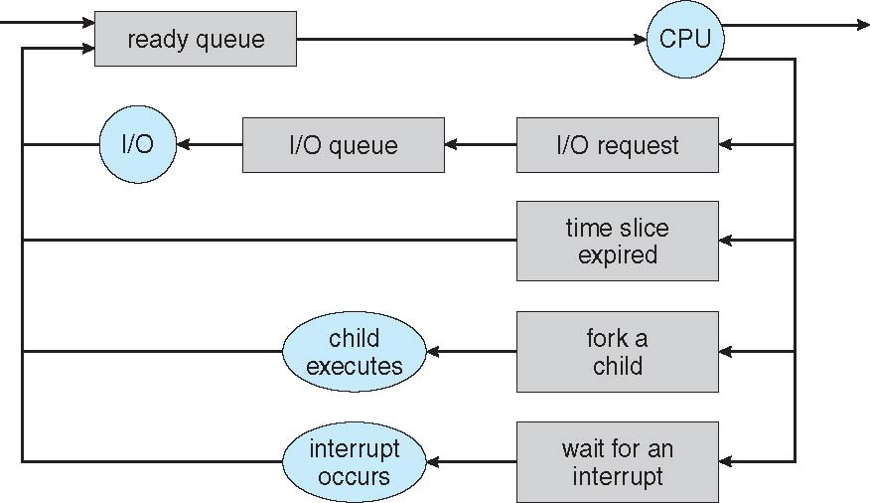
Representation of Process Scheduling

Slide 5
Types of Schedulers
Long-term scheduler (or job scheduler) – selects which processes should be brought into the ready queue
Short-term scheduler (or CPU scheduler) – selects which process should be executed next and allocates CPU
The long-term scheduler controls the degree of multiprogramming

Slide 6
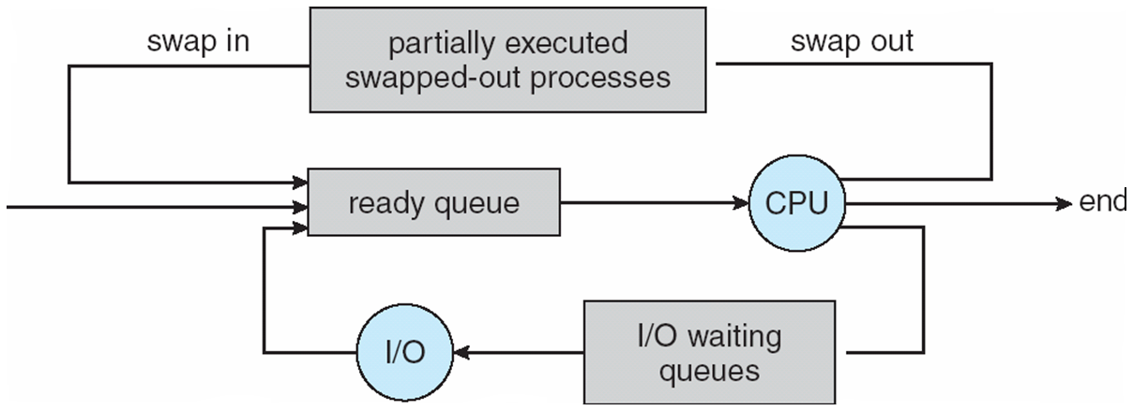
Addition of Medium Term Scheduling

Slide 7
Schedulers(cont.)
Processes can be described as either:
I/O-bound process – spends more time doing I/O than computations, many short CPU bursts
CPU-bound process – spends more time doing computations; few very long CPU bursts

Slide 8
Scheduling Algorithms(1)
Policy: which process to run
Mechanism: how to “context switch” between
processes

Slide 9
Scheduling Algorithms(2)
The policy which process to run next, from set of ready processes?
OS scheduler schedules the CPU requests (bursts) of processes
– CPU burst = the CPU time used by a process in a continuous stretch
– If a process comes back after I/O wait, it counts as a fresh CPU burst

Slide 10
Scheduling Algorithms(3)
Goals:
Maximize utilization = fraction of time CPU is used
Minimize average turnaround time = time from process arrival to completion
Minimize average response time = time from process arrival to first scheduling
Fairness: all processes must be treated equally
Minimize overhead: run process long enough to amortize cost of context switch (~1 microsecond)

Slide 11
Scheduling Algorithms(4)
Arrival Time: Time at which the process arrives in the ready queue.
Burst Time: Time required by a process for CPU execution.
Waiting Time(W.T): Total time spent by the process in the ready state waiting for CPU. Waiting Time = Turn Around Time – Burst Time

Slide 12
Scheduling Algorithms(5)
Turn Around Time: Total amount of time spent by the process from coming in the ready state for the first time to its completion.
Turn Around Time = Completion Time – Arrival Time
Turnaround time = Waiting time + Burst time
Completion Time: Time at which process completes its execution.

Slide 13
Scheduling Algorithms(6)
Types of Algorithms:
Pre-emptive : allows a running process to be interrupted by a high priority process
Non Pre-emptive: any new process has to wait until the running process finishes its CPU cycle.

Slide 14
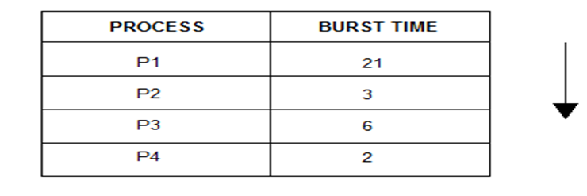
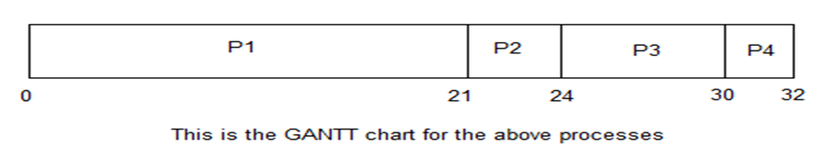
First Come First Serve(1)
Non Pre-emptive

Slide 15
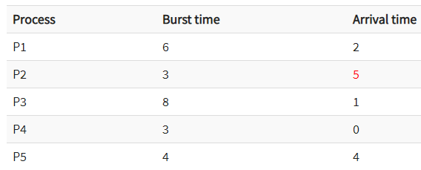

First Come First Serve(1)
Grantt Chart:
Average waiting time: (0+2+9+13+16)/5 = 8

Slide 16
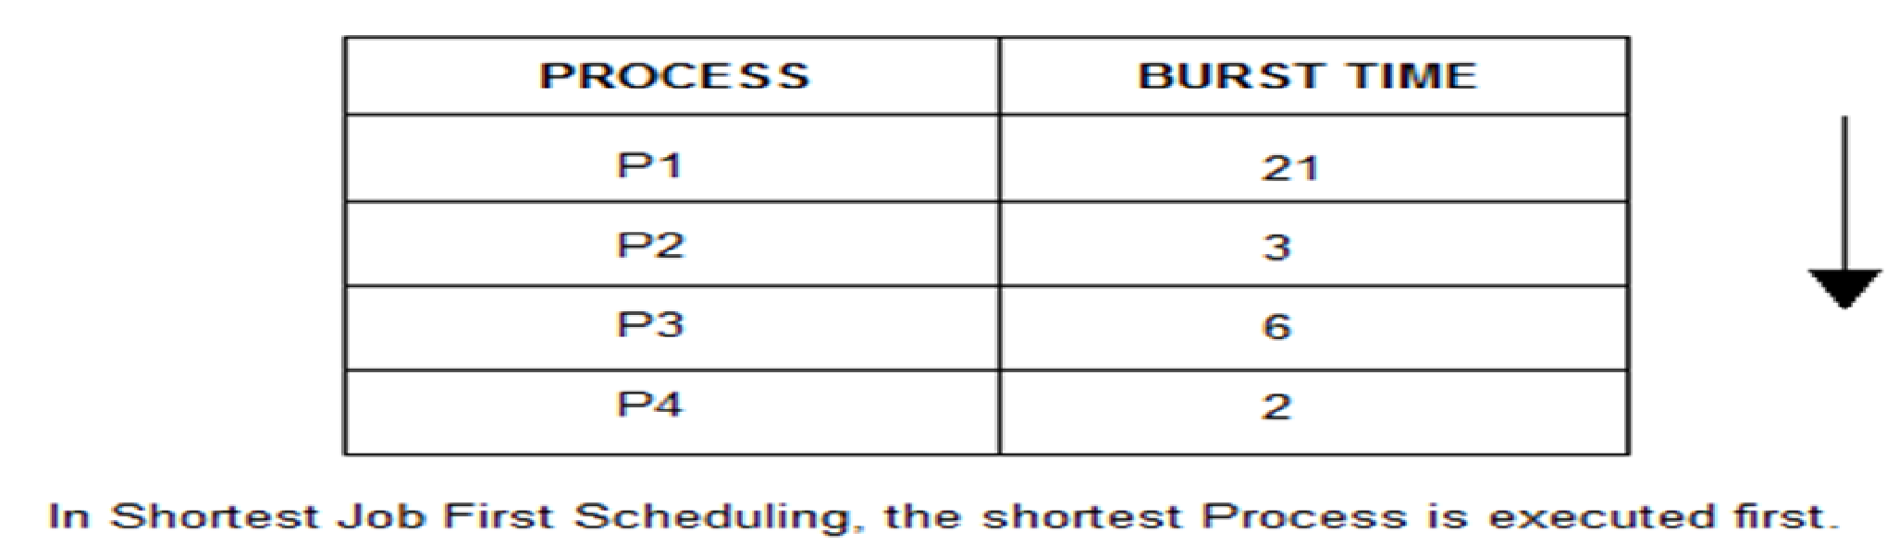
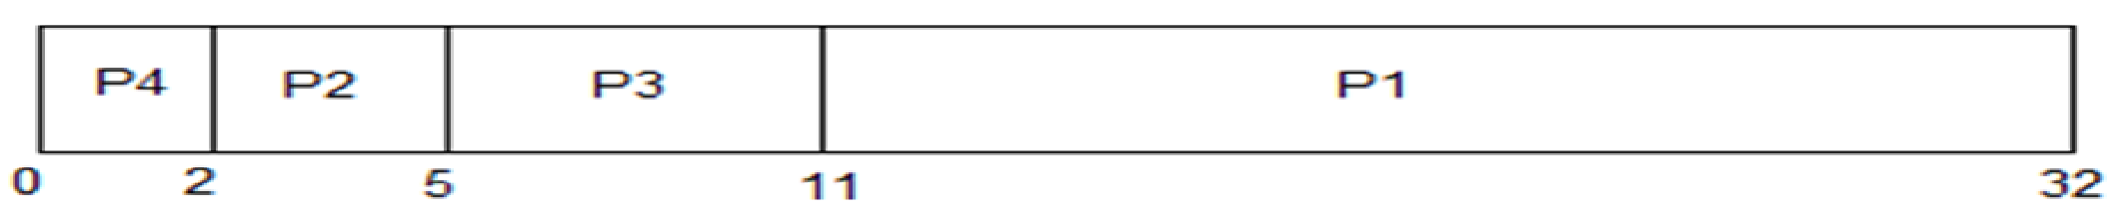
Shortest Job First(1)
Non Pre-emptive

Slide 17
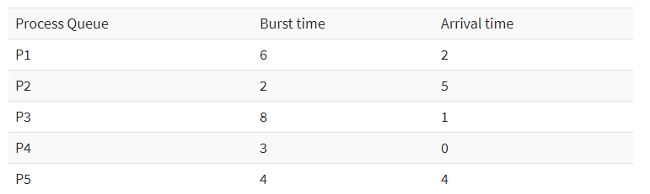

Shortest Job First(1)
Ready queue: p1p2p5 p3

Slide 18
Priority Scheduling(1)
Process selected based on priority
The lowest priority gets the CPU first
Can be both pre-emptive and non pre-emptive

Slide 19
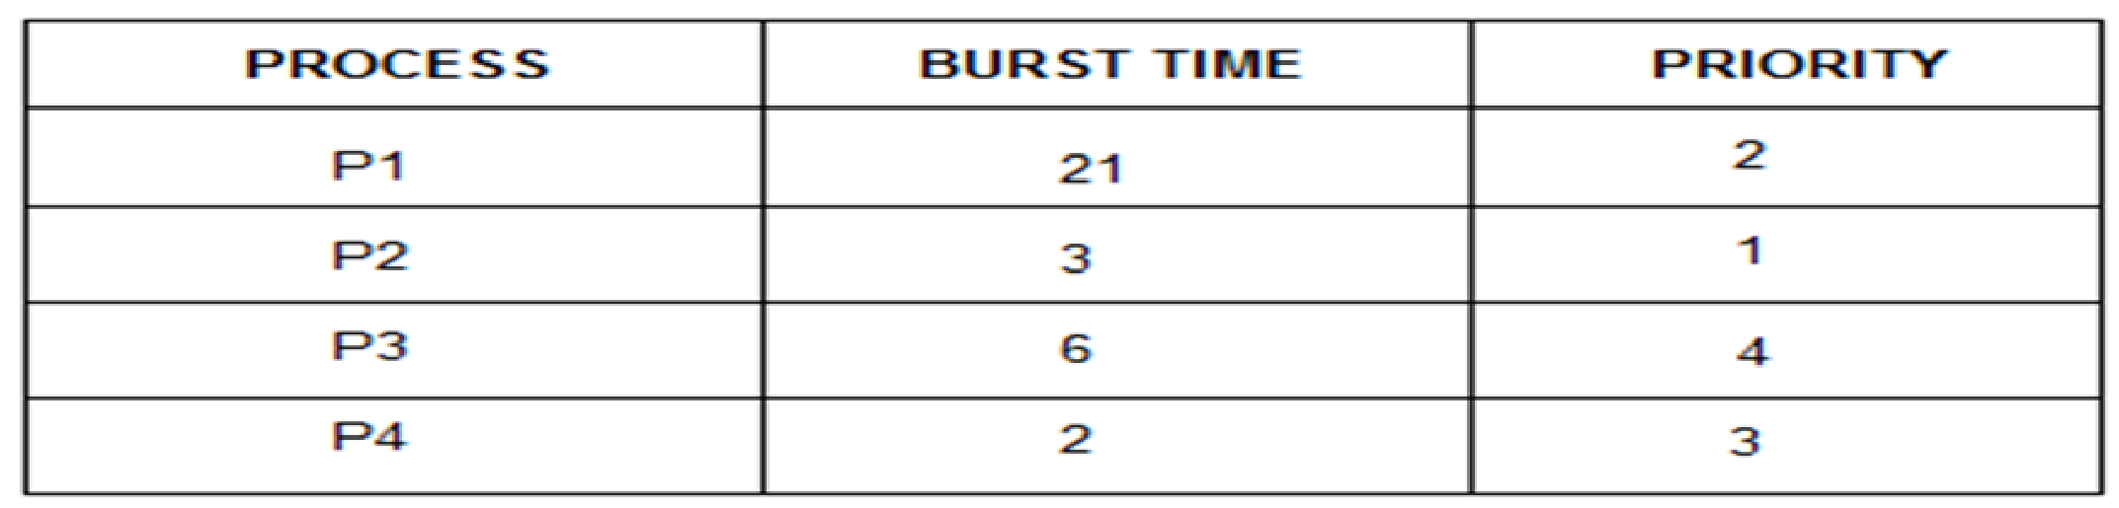
Priority Scheduling(Non pre-emptive)
r.q: p2 p1 p4 p3

Slide 20
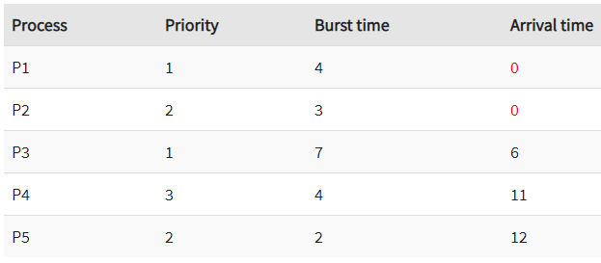

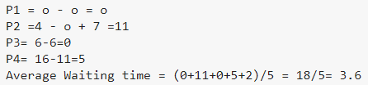
Priority Scheduling(Pre-emptive)
r.q:
p5=14-12=2

Slide 21
Round Robin(1)
Pre-emptive
Each process gets a small unit of CPU time (time quantum), usually 10-100 milliseconds. After this time has elapsed, the process is preempted and added to the end of the ready queue.

Slide 22
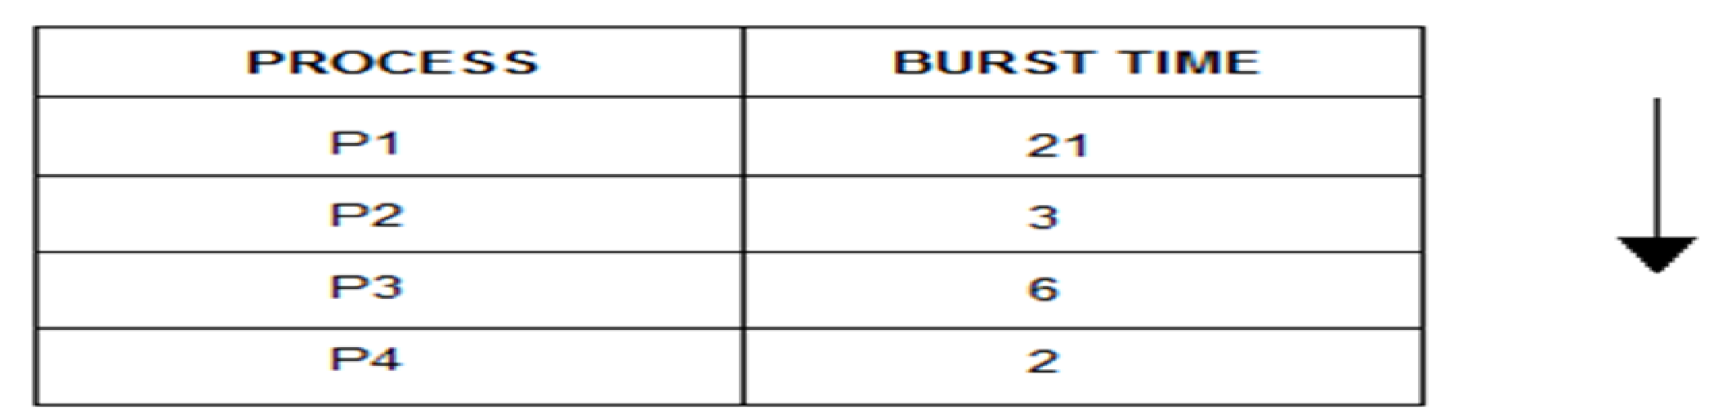
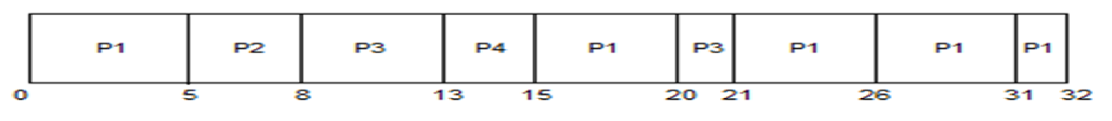
Round Robin(2)
P1=0+(15-5)+(21-20)
P2=5, p3=8+(20-13)
P4=13
Here, Quantam = 5

Slide 23
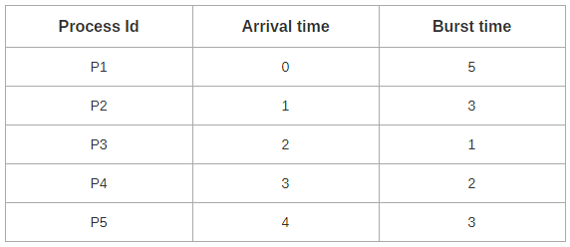

Round Robin(3)
P1=0+3+5, p2=1+7, p3=2,p4=4
P5=5+2
Quantam=2
Readu queue:

Slide 24
Some animation links…
First come first serve:
https://www.youtube.com/watch?v=iiBij98FtHg
Shortest job first:
https://www.youtube.com/watch?v=ngHgEqYZeyg
Priority Scheduling (Pre-emptive)
https://www.youtube.com/watch?v=2NB53crEWn4
Round Robin Scheduling:
https://www.youtube.com/watch?v=hy5dn9mK36I

Slide 25
Thank you!!!!

